Slide 1
Introduction to Gosu
13 June 2013
Notes:
Guidewire training materials contain Guidewire proprietary information that is subject to confidentiality and non-disclosure agreements. You agree to use the information in this manual solely for the purpose of training to implement Guidewire software solutions. You also agree not to disclose the information in this manual to third parties or copy this manual without prior written consent from Guidewire. Guidewire training may be given only by Guidewire employees or certified Guidewire partners under the appropriate agreement with Guidewire.

Slide 2
Lesson objectives
By the end of this lesson, you should be able to:
Describe the ways that Guidewire applications use Gosu
Write Gosu using basic Gosu syntax
Describe Studio features that aid in the writing of Gosu
This lesson uses the notes section for additional explanation and information. To view the notes in PowerPoint, choose View→Normal or View→Notes Page. If you choose to print the notes for the lesson, be sure to select “Print hidden slides.”

Slide 3
Lesson outline
Guidewire Gosu overview
Gosu statements
Gosu objects
Gosu subtypes
Gosu Scratchpad

Slide 4
Guidewire Gosu
Gosu is Guidewire's programming language
Has elements of both procedural and object-oriented programming languages
Similar to Java
Gosu specifies runtime business logic that:
Executes fundamental application behavior
Manages complex business processes
Specifies dynamic client-side behavior
Notes:
Guidewire developed Gosu for several reasons. First, there was a desire to have a single syntax that could be used to work with all of the elements relevant to Guidewire products (such as entities, display keys, classes, class enhancements, Java classes, permissions, and script parameters) even though these items have fundamentally distinct internal implementations. There was no existing language that provided this ability. Second, there was a desire to have a code auto-complete feature in Studio. This is possible only with a statically-typed language. Most scripting languages, such as JavaScript, Perl, Python, and Ruby, are dynamically typed.
Prior to ClaimCenter 6.0, PolicyCenter 4.0, and BillingCenter 3.0, Gosu was known as "GScript".

Slide 5





Where is Gosu used? (1)
Business rules
Execute fundamental application behavior, such as activity assignment
Entity enhancements
Extend entity functionality with new methods, such as a new UpdateEmployees() method for ABCompany
Gosu classes
Create general purpose classes, such as logging utilities, plugins, and entities used to pass information to external applications
Rules
Enhancements
Classes
PCFs
Workflows

Slide 6
Where is Gosu used? (2)
PCFs
Specify user interface layout and dynamic behavior, such as "inspection date" field being visible only when "inspection needed" set to true
Workflows
Executes processes whose execution is time-based, or triggered by events in external applications, or both
Currently, used only by PolicyCenter and BillingCenter base applications
Rules
Enhancements
Classes
PCFs
Workflows
Notes:
Workflows are available in all three primary Guidewire applications. They are used in PolicyCenter to manage policy transactions (such as renewals), and in BillingCenter to manage account delinquency and agency bill cycles. Although the feature is available in ClaimCenter, it is not used by the ClaimCenter base application.

Slide 7
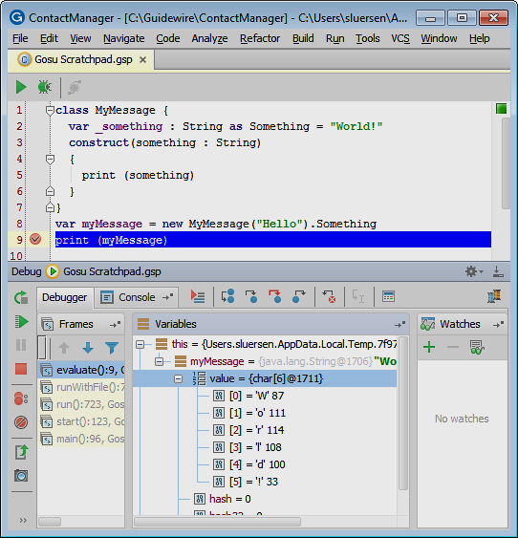
Gosu Scratchpad
Write, execute and debug Gosu code
Common editor features supported
Gutter Area
Smart completion
Validation bar
Consists of
Code editor
Debug window
Run window
Notes:
Gosu Scratchpad is Guidewire Studio code editor that lets you write, run and debug Gosu code. You can use Gosu scratchpad to run and debug Gosu code in Gosu Scratchpad or in to debug code in the Run Debug Process for the given Guidewire application project.

Slide 8
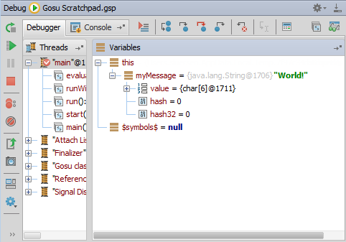
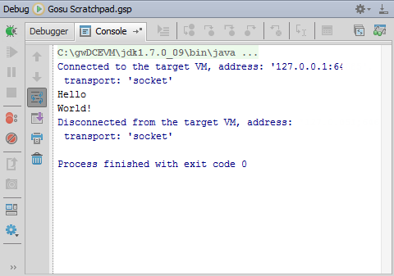
Gosu Scratchpad: Debug window
Alt + 5
Opens Debug window
Debugger tab
Rerun, Resume, Pause, Stop
View breakpoints
Step over, into and out
Inspect and watch
Console tab
View output
Notes:
The debugger enables you to execute your application step by step, examine program information related to variables, watches, or threads, and change your program without leaving Guidewire Studio.

Slide 9
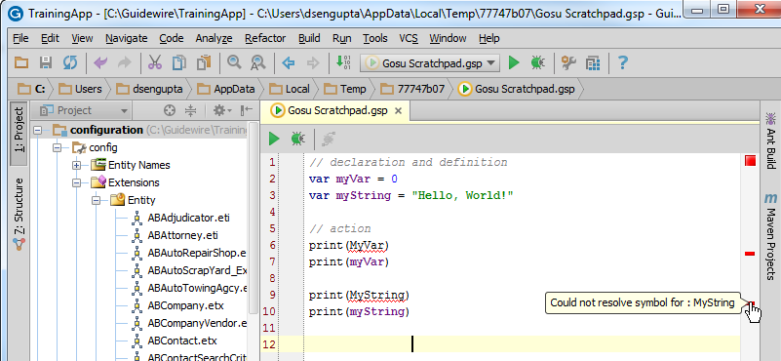
Gosu case sensitivity
Gosu is case-sensitive
Notes:
As of Carbon, the Gosu language was not case-sensitive. However in the current release, all Gosu is case sensitive. The compiler will not resolve cases not following the convention. In the example, the variable “myVar” is declared and defined, then referred to later. You must refer to the variable exactly as it was declared in order for the variable to be compiled.

Slide 10
Lesson outline
Guidewire Gosu overview
Gosu statements
Gosu objects
Gosu subtypes
Gosu Scratchpad

Slide 11
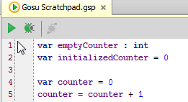
Variables
Syntax to declare variables:
var variableName : datatype
var variableName = initialValue
Syntax to set variable values:
variableName = newValue
Notes:
A variable is a temporary container of data. Every variable has a name.
When you create a variable, you must state its datatype either directly or indirectly. You can do it directly using the colon syntax as shown on line 1 of the code above. This creates a variable with a known datatype but no initial value—the value is null. Alternately, you can create the variable and set it to an initial value (as shown on line 2 of the code above), in which case the compiler infers the datatype from the initial value.
In Gosu, variable datatypes include int, boolean, and String.
Gosu uses the standard programming assignment operator = to assign the value on the right-hand side of the statement to the item on the left-hand side of the statement.

Slide 12
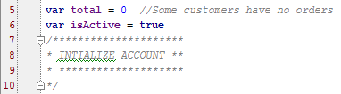
Comments
Single-line comment
// comment
CTRL + SHIFT + / toggles selected lines to have or not have single-line comments
Multiple-line comment
/* comment */
Notes:
A comment is a set of characters that the compiler does not attempt to compile. Comments are used by the programmer to document some fact about the code, such as when it was written, what its purpose is, and so on. Comments are also used to make code more readable.
A "//" comments out the remainder of the line until a carriage return is encountered. A "/*" comments out all text until a "*/" is encountered.
Gosu uses the same comment syntax as Java.

Slide 13
Statements
Statements in Gosu do not require a terminator to mark end of statement
Compiler determines end of statement based on syntax
statement
Notes:
In some programming languages, statements must be explicitly terminated. The semi-colon is one of the most common statement terminators, though some languages use other symbols and some use a carriage return.
Semicolons can be used in Gosu to terminate statements. This is not required, however, because the compiler can parse statements without them. Given that they are not required, Guidewire recommends that you not use semicolons. Guidewire also recommends using carriage returns and white space to make it clear to others reading the code where a given statement ends.
The semicolon is allowed (but ignored) as a line terminator:
var total = 0;
var isActive = true;

Slide 14
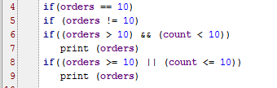
Conditions and comparison operators
Common comparison operators:
Equality: ==, !=
Relational: >, <, >=, <=
Compound: && (“and”) || (“or”)
Notes:
The AND and OR operators can also be entered as "and" and "or" (using lower-case letters).
As with most other scripting languages, in Gosu the "is equal to" comparison operator uses two equals signs ("=="), while the assignment operator uses one ("="). For example:
var count = 3 // Declare a new variable named "count" and
// assign it the number 3.
count = 4 // Now assign it the number 4
if (count == 4 )... // The if expression is true because "count"
// contains the number 4.
if (3 == 4)... // The if expression is false because 3 does
// not equal 4.
if (3 != 4)... // The if expression is true because 3 does
// not equal 4.
3 = 4 // This statement will not compile. You cannot
// assign a value (such as 4) to a number
// (such as 3).

Slide 15
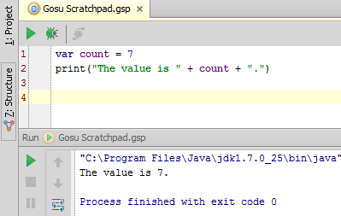
Concatenation operator
Concatenates two or more values into a single string
Syntax: value + value

Slide 16
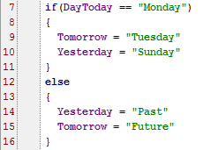
if/else statements
Syntax: if (condition)
statement_or_{block} else
statement_or_{block}
Notes:
Each branch of the if-else can be followed by either:
A single statement
A series of statements enclosed in { }
The else branch is optional.

Slide 17
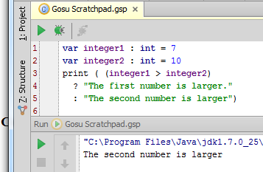
Ternary operator
Similar to if-else, but can only return expressions
It cannot execute statements
Typically used in PCF files where if-else statements are cumbersome
Syntax: condition ? returnValueIfTrue : returnValueIfFalse
Notes:
Parentheses are not required around the condition of a ternary operator. They are often added for the sake of clarity or to establish an order of precedence, however.

Slide 18
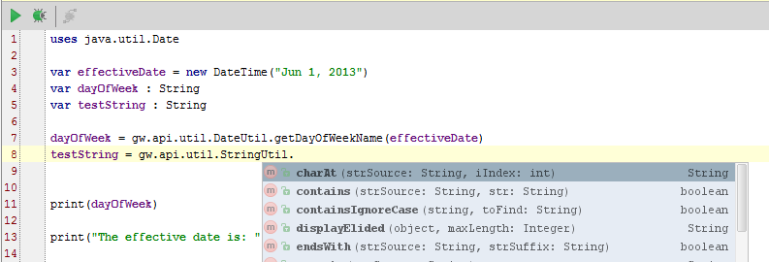
Gosu method libraries
Available in all base applications
Syntax to reference method:
gw.api.util.DateUtil.FunctionName(arguments)
gw.api.util.StringUtil.FunctionName(arguments)
gw.api.util.Math.FunctionName(arguments)
Notes:
A library is a collection of methods that you can call from within your Gosu programs. Guidewire provides a number of standard library methods (in gw.api.* packages, for example). The gw.api.util Gosu API contains utility libraries such as Math, Logger, Date, String, and Array classes. Commonly used methods are listed on the next slide.

Slide 19
Lesson outline
Guidewire Gosu overview
Gosu statements
Gosu objects
Gosu subtypes
Gosu Scratchpad

Slide 20
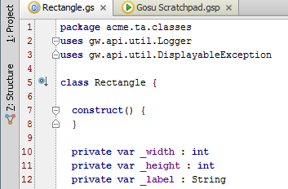
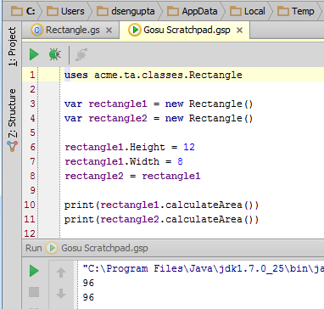
Objects
Syntax to create new variable: var objectName = new datatype()
Syntax to set variable to given object:
objectName = someOtherObject
New variables
Set variable to other objects
Notes:
A Gosu class is a general “blueprint” for objects you create in Gosu. You instantiate classes when you create an object; that is, you create an object based on a Gosu class.
Unlike a variable, which stores a single simple value, an object has a more complex structure. It consists of a set of properties, each of which stores a single value (which may be a simple boolean, string, or numeric value, or a foreign key pointing to a related object), and a set of methods, which are methods associated specifically with that object.
You can create a new object in Gosu using the syntax shown above. In this example, a second object, rectangle2, is set to rectangle1. All the properties are the same, so the calculated area is the same.

Slide 21
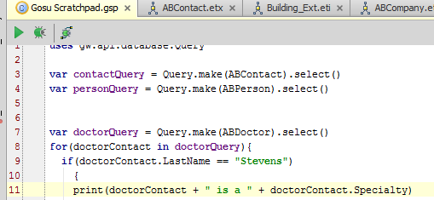
Access object properties
Object properties are accessible using Gosu
An object has properties, which describe an object’s state
Specialty is a property of the ABDoctor entity, doctorContact
Notes:
Objects in the database have properties that are accessible through Gosu. In this example, several properties, including Specialty, describe the ABDoctor object.

Slide 22
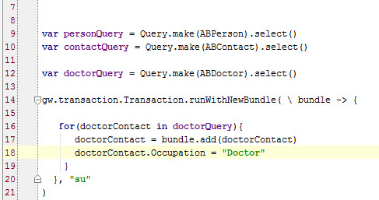
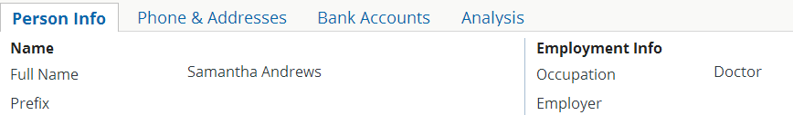
Edit object properties
NOTE: To add or edit object properties, use Gosu bundles, which are covered in a later lesson.
Notes:
You can also change or add properties in Gosu. In this example, the Occupation field remains empty until Line 18 executes, changing the value to “Doctor”.

Slide 23
Lesson outline
Guidewire Gosu overview
Gosu statements
Gosu objects
Gosu subtypes
Gosu Scratchpad

Slide 24
Subtyped entities
Guidewire entities may have subtypes
Each subtype inherits the properties and methods of all their supertypes
Subtypes typically have their own properties and/or methods
AssignedUser EmailAddress
ABContact
FirstName LastName
ABPerson
ABPerson Vendor
AttorneyLicense AttorneySpecialty
ABAttorney
DoctorSpecialty MedicalLicense
ABDoctor
Notes:
A subtype is an entity that is declared as a child of another "parent" entity. The child entity inherits all properties and methods of the parent. For example, the diagram above shows that ABPerson is a subtype of ABContact. An object of type ABPerson has FirstName and LastName properties (which are declared explicitly in the ABPerson entity) and AssignedUser and EmailAddress properties (which it inherits from ABContact because it is a subtype of ABContact).
Subtypes are useful when you have a hierarchical collection of objects where the same sort of information is needed for sets of objects. For example, all contacts have assigned users and email addresses. All person contacts (but not companies or places) have first names and last names. By creating ABPerson as a subtype of ABContact, you do not need to re-declare the fields shared by ABPerson, ABPlace, and ABCompany.

Slide 25
Dot notation and subtyped objects
run-time memory
var JLee : ABContact
ABContact
Name: James Lee EmailAddress: null Subtype: ABDoctor
FirstName: James Gender: male LastName: Lee
MedicalLicense: AB3244
JLee
ABContact fields
ABPerson fields
(JLee as ABDoctor)
ABDoctor fields
Server infers structure of object based on datatype as specified in PCF file
(next object)
Notes:
When a Guidewire application retrieves data from the database, it stores that data as an object in runtime memory. It works with the in-memory information until the data needs to be committed or re-retrieved from the database.
When an object is created, all of the information about the object is copied into memory. If the object is subtyped, then data for all the fields at every relevant subtype level is retrieved. For example, if an object is an ABDoctor, then information is copied over for fields at the ABContact, ABPerson, ABPersonVendor, and ABDoctor levels. Fields associated with ABPlace, ABCompany, or ABAttorney are irrelevant and therefore ignored.
When an object is referenced, the server uses the datatype of the reference to understand the structure of the information in memory. For example, assume that there is an object named "JLee" that stores information about an ABDoctor. If there is a reference to this object with a datatype of "ABDoctor", then the server knows that the object will have ABContact fields, ABPerson fields, ABPersonVendor fields, and ABDoctor fields. If there is a reference to this object with a datatype of "ABPerson", then the server knows that the object will have ABContact fields and ABPerson fields, but it will assume that the object has no fields beyond the ABPerson fields. There may be additional fields with information at the ABPersonVendor and ABDoctor levels, but the server will be unaware of them.
In some cases, a method or user interface container receives a reference to an object, and the reference uses a "high-level" datatype (such as ABContact). This reference cannot be used as-is to access fields below the specified level because the server assumes those fields do not exist. There is a programming technique known as casting in which you explicitly state the datatype for a subtyped object. This is done using the syntax "as <datatype>", where <datatype> is the datatype that you want to explicitly identify. When you cast a reference, you are providing the server with more information about the structure of the object. A casted reference can access fields that an uncasted reference cannot.

Slide 26
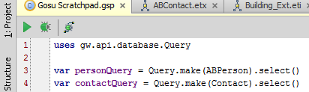
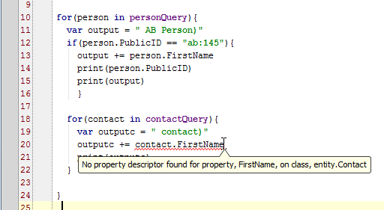
Directly referencing subtype fields
When working with an object of given subtype, you can directly reference only fields and methods at or above that subtype
You cannot directly reference fields or methods below that subtype
Notes:
In the example above, two objects are created. Although they are both initialized using ABPerson objects from the database, one is created as an ABPerson and the other as an ABContact.
Line 13 shows that you can directly reference fields at or above the object's level. The object is an ABPerson. FirstName is at the ABPerson level. Line 20 shows that you cannot directly reference a field below the object's level. The object is an ABContact and FirstName is below ABContact at the ABPerson level, so it cannot be directly referenced.

Slide 27
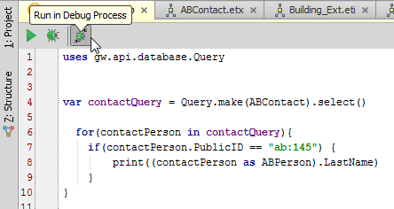
Indirectly referencing subtype fields
When working with an object of given subtype, you can indirectly reference fields and methods below that subtype by indicating child subtype where field is declared
Syntax: ( object as childSubtype ).fieldOrMethod
Notes:
The technique shown above (where an object's subtype is explicitly referenced) is referred to as "casting".

Slide 28
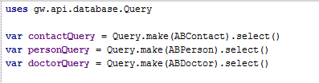
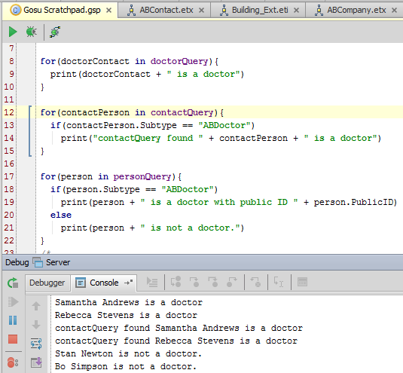
Testing an object's type: subtype field
Queries
“Subtype” identifies object's subtype
1
2
3
1
2
3
Notes:
You can check the subtype property of an object using the Subtype property. In this example, three queries are constructed (Queries). Each query is for a different type. The print statement marked “1”, shows which contacts are type ABDoctor (Line 9).
The conditional statements at lines 13 and 18-20 both check the subtype for the query result. Line 13 checks all contacts for type ABDoctor on the query results of type ABContact. To check, you use the Subtype property. Similarly, a check for Subtype “ABDoctor” on the query results of type ABPerson appears between lines 18-20.
1 – print ABDoctor results for query that returned only ABDoctor results
2 – check which ABContacts are of type ABDoctor using Subtype property
3 – check which ABPerson results are of type ABDoctor using Subtype property

Slide 29
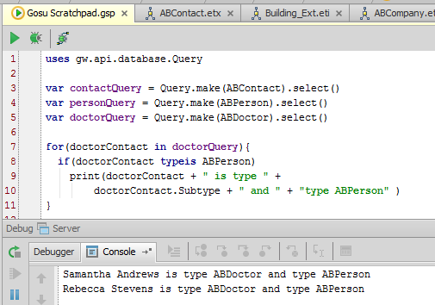
Testing an object's type: typeis
typeis returns true if object is of given subtype, either directly or indirectly
Syntax: ( object typeis Subtype )
Notes:
The object.Subtype operator is useful when you need to know a given object's specific subtype. For example, if you want to test if an object is an ABPerson (but not an ABPersonVendor, ABDoctor, or ABAttorney), then you would reference the object's Subtype field. The typeis operator is useful when you need to know if a given object is of a given subtype or any of its child subtypes. For example, if you want to test if an object is an ABPerson or any of its subtypes (such as ABPersonVendor, ABDoctor, or ABAttorney), then you would use typeis.
In the example above, sampleDoctor is an ABPerson (indirectly), and samplePerson is an ABPerson (directly). Lines 9-10 print that the type is both ABDoctor and ABPerson. The type is ABPerson because the conditional statement checks doctorContact’s type.
Automatic casting of the typeis operator
When you use the typeis operator in an if statement to check an object's type and the operator returns true, Gosu automatically casts the object to the given subtype for the scope of the if statement. You do not need to cast the object explicitly, and Gosu provides a warning if you do cast it explicitly.
For example, observe the following code:
01 var aContact = ABContact(5)
02 print (aContact.FirstName)
03 print ((aContact as ABPerson).FirstName)
04 if (aContact typeis ABPerson) {
05 print (aContact.FirstName)
06 print (aContact as ABPerson).FirstName) }
Line 02 will not compile. This is because the parser understands aContact to be an ABContact, and there is no FirstName field for ABContacts.
Line 03 will compile. This is because aContact has been explicitly cast as an ABPerson, and the parser knows there is a FirstName field for ABPersons.
Line 05 will compile. This is because line 4 uses the typeis operator to check if aContact is an ABPerson. If it returns true, then the parser automatically casts aContact to the ABPerson type.
Line 06 will compile, but the syntax checker will display a warning. This is because the typeis operator has implicitly cast aContact, and the explicit casting is not necessary.

Slide 30
Lesson outline
Guidewire Gosu overview
Gosu statements
Gosu objects
Gosu subtypes
Gosu Scratchpad

Slide 31
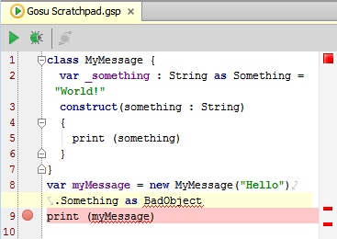

Gosu Scratchpad: code editor
Editor toolbar
Run and Debug
Debug in application process
Gutter
Show Line Numbers, Indent Guides, and Use Soft wraps
Set Break points
Validation bar
Red marks syntax error
Code completion
Basic and smart
Context Menu
Paste Java as Gosu
Notes:
You can use Guidewire Studio to complete your code by placing your cursor at the end of a valid object and typing a dot (. ). This action causes Studio to open a pop-up window that contains all the properties, methods, and objects that are possible for this context. As you type, Studio filters this list to include only those choices that match what you have typed thus far. Use the down arrow to highlight the item you want and press Enter or Tab to select it. If the selection is not the initial default selection, you can also use the Space bar.

Slide 32
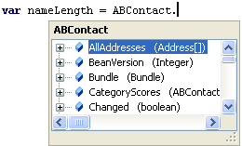
Code completion features
Dot completion
Enter dot (.) after object name
Studio opens popup which lists its fields and methods
List is filtered as you type
SmartHelp
Light-bulb icon indicates SmartHelp available for current line
Click icon for a list of choices
CTRL + Space and CTRL + / open a selection popup to help you complete a partial expression or value
Notes:
Guidewire Studio provides several different ways of obtaining information about application objects and APIs to assist you in writing valid rules and Gosu code. These include:
Dot completion
You can use Studio to complete your code by placing your cursor at the end of a valid object or sub-object and typing a dot ( . ). This action causes Studio to open a pop-up window that contains all the sub-objects and methods that are valid for this object in this context.
As you type, Studio filters this list to include only those choices that match what you have typed thus far. Use the down arrow to highlight the item you want and press Enter, the space bar, or Tab to select it. After you select an item, Studio inserts it in the correct location in the code.
SmartHelp
As you type in a Studio editor, Studio assists you in entering valid code through the use of its SmartHelp feature. Studio uses a light-bulb icon to indicate that SmartHelp is available for the current line of code.
Ctrl+Space
This keyboard shortcut opens a popup for completing the partial statement at the current point. It lists objects and methods that would be legal to enter at that point in the statement.
Ctrl+Slash
This keyboard shortcut opens a popup for completing the value at the current point (for example, on the right hand side of an assignment to a typekey).

Slide 33
Gosu Scratchpad: Debug window
Alt + 5
Opens Debug window
Debugger tab
Rerun, Resume, Pause, Stop
View breakpoints
Step over, into and out
Inspect and watch
Console tab
View output
Notes:
The debugger enables you to execute your application step by step, examine program information related to variables, watches, or threads, and change your program without leaving Guidewire Studio.

Slide 34
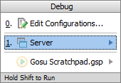

Steps to run in a debug process
Debug Server
Alt + Shift + F9
Select Server
Console tab
Verify output reads application ready
Open Gosu scratchpad
Alt + Shift + S
Enter Gosu code in scratchpad
Able to reference project entities, classes, libraries, and SDK
Run in Debug Process
No connection dialog!
*** ContactManager ready ***
Notes:
When you Run in a Debug Process with Gosu Scratchpad for your Guidewire application, you do not need to specify, by default, a connection to your Guidewire application.

Slide 35
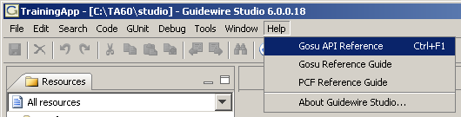
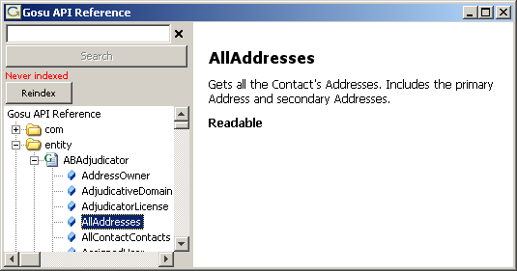
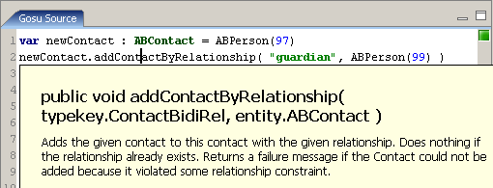
Gosu API Reference
Gosu API Reference documents each entity, its fields, and its methods
You can display help for given method by clicking in name and pressing F1

Slide 36
Lesson objectives review
You should now be able to:
Describe the ways that Guidewire applications use Gosu
Write Gosu using basic Gosu syntax
Describe Studio features that aid in the writing of Gosu

Slide 37
Notices
Copyright © 2001-2013 Guidewire Software, Inc. All rights reserved.
Guidewire, Guidewire Software, Guidewire ClaimCenter, Guidewire PolicyCenter, Guidewire BillingCenter, Guidewire Reinsurance Management, Guidewire ContactManager, Guidewire Vendor Data Management, Guidewire Client Data Management, Guidewire Rating Management, Guidewire InsuranceSuite, Guidewire ContactCenter, Guidewire Studio, Gosu, Deliver Insurance Your Way, and the Guidewire logo are trademarks or registered trademarks of Guidewire Software, Inc. in the United States and/or other countries.
This material is Guidewire proprietary and confidential. The contents of this material, including product architecture details and APIs, are considered confidential and are fully protected by customer licensing confidentiality agreements and signed Non-Disclosure Agreements (NDAs).
This file and the contents herein are the property of Guidewire Software, Inc. Use of this course material is restricted to students officially registered in this specific Guidewire-instructed course, or for other use expressly authorized by Guidewire. Replication or distribution of this course material in electronic, paper, or other format is prohibited without express permission from Guidewire.
Guidewire products are protected by one or more of the following patents: U.S. Patents 6,073,109; 6,058,413; 5,734,837; 5,630,069; 5,208,748; 7,885,831; 7,788,296.

